Slide 1
Feature selection package with IHT
Konstantin Pakulev, Viacheslav Pronin

Slide 2
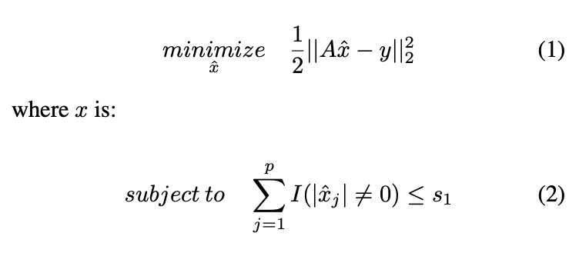
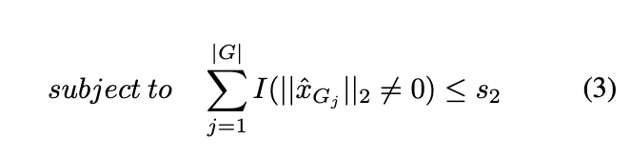
The formulation of the problem
The problem of feature selection can be summarized as follows:
Alternatively the constraints that account for the grouping properties can be applied:

Slide 3
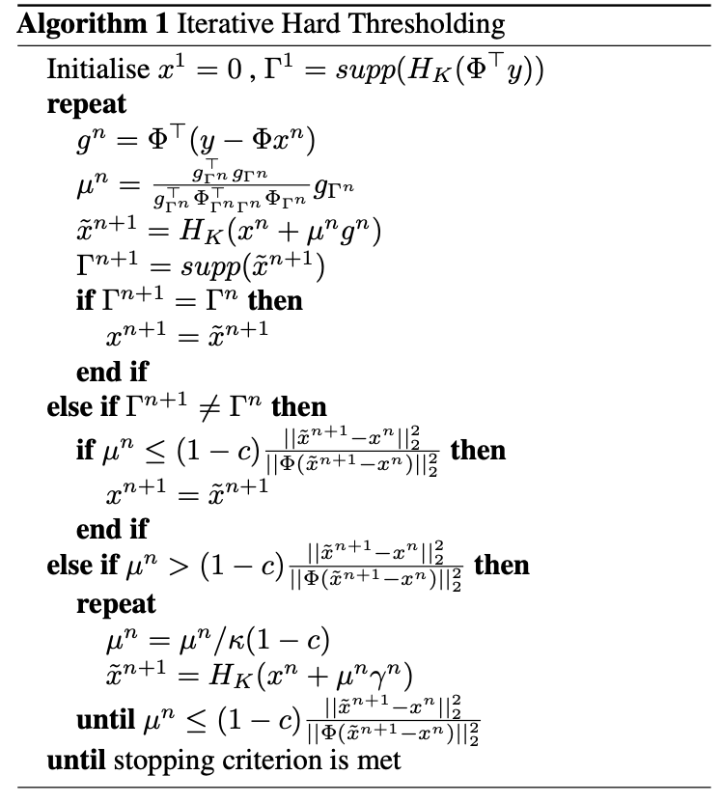
Iterative Hard Thresholding
Perform gradient descent while setting the magnitude of all elements but topk to zero
If sets of topk elements are different between iterations there are options:
The step size is less than w and everything is ok
The step size is less than w and it needs to be reduced

Slide 4
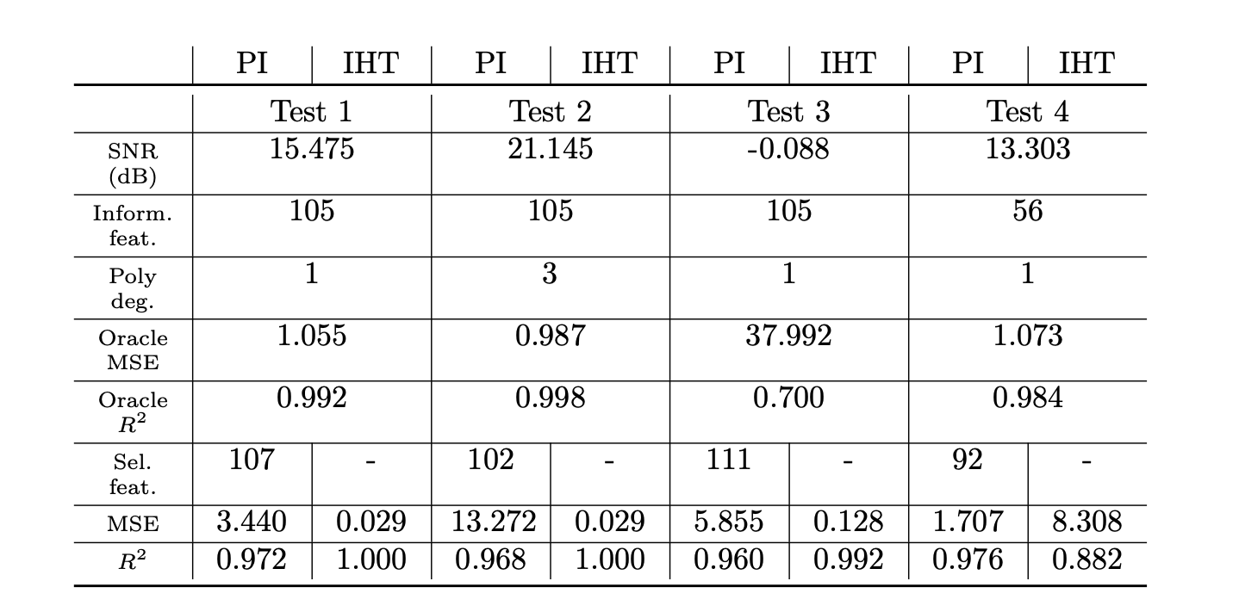

Evaluation results
Test dataset is generated via the linear model:

